Slide 1
Training Guide

Slide 2
What do we do?

Slide 3
Jobs Advertising We have three main websites where we advertise Jobs The Kumara Vine The Job Market Wellington Today We sometimes advertise jobs on our regional websites like Taranaki Today Kapiti Now & Auckland Coffee Club NB: We market jobs through our websites and across a multitude of social media platforms to help our clients by ensuring many people see their job adverts

Slide 4
Kiwi Business Network The Kiwi Business Network (KBN) is a business network that supports small New Zealand Business around Aotearoa. KBN has three main services. 1.We are a business network 2.We build digital marketplaces across the country e.g. Kapiti Now 3. We provide Digital Marketing training to our members Our Members pay $250+GST per year to be in this network. Visit www.kiwibusinessnetwork.com to see the types of business members we have and the many regions we are now working on.

Slide 5
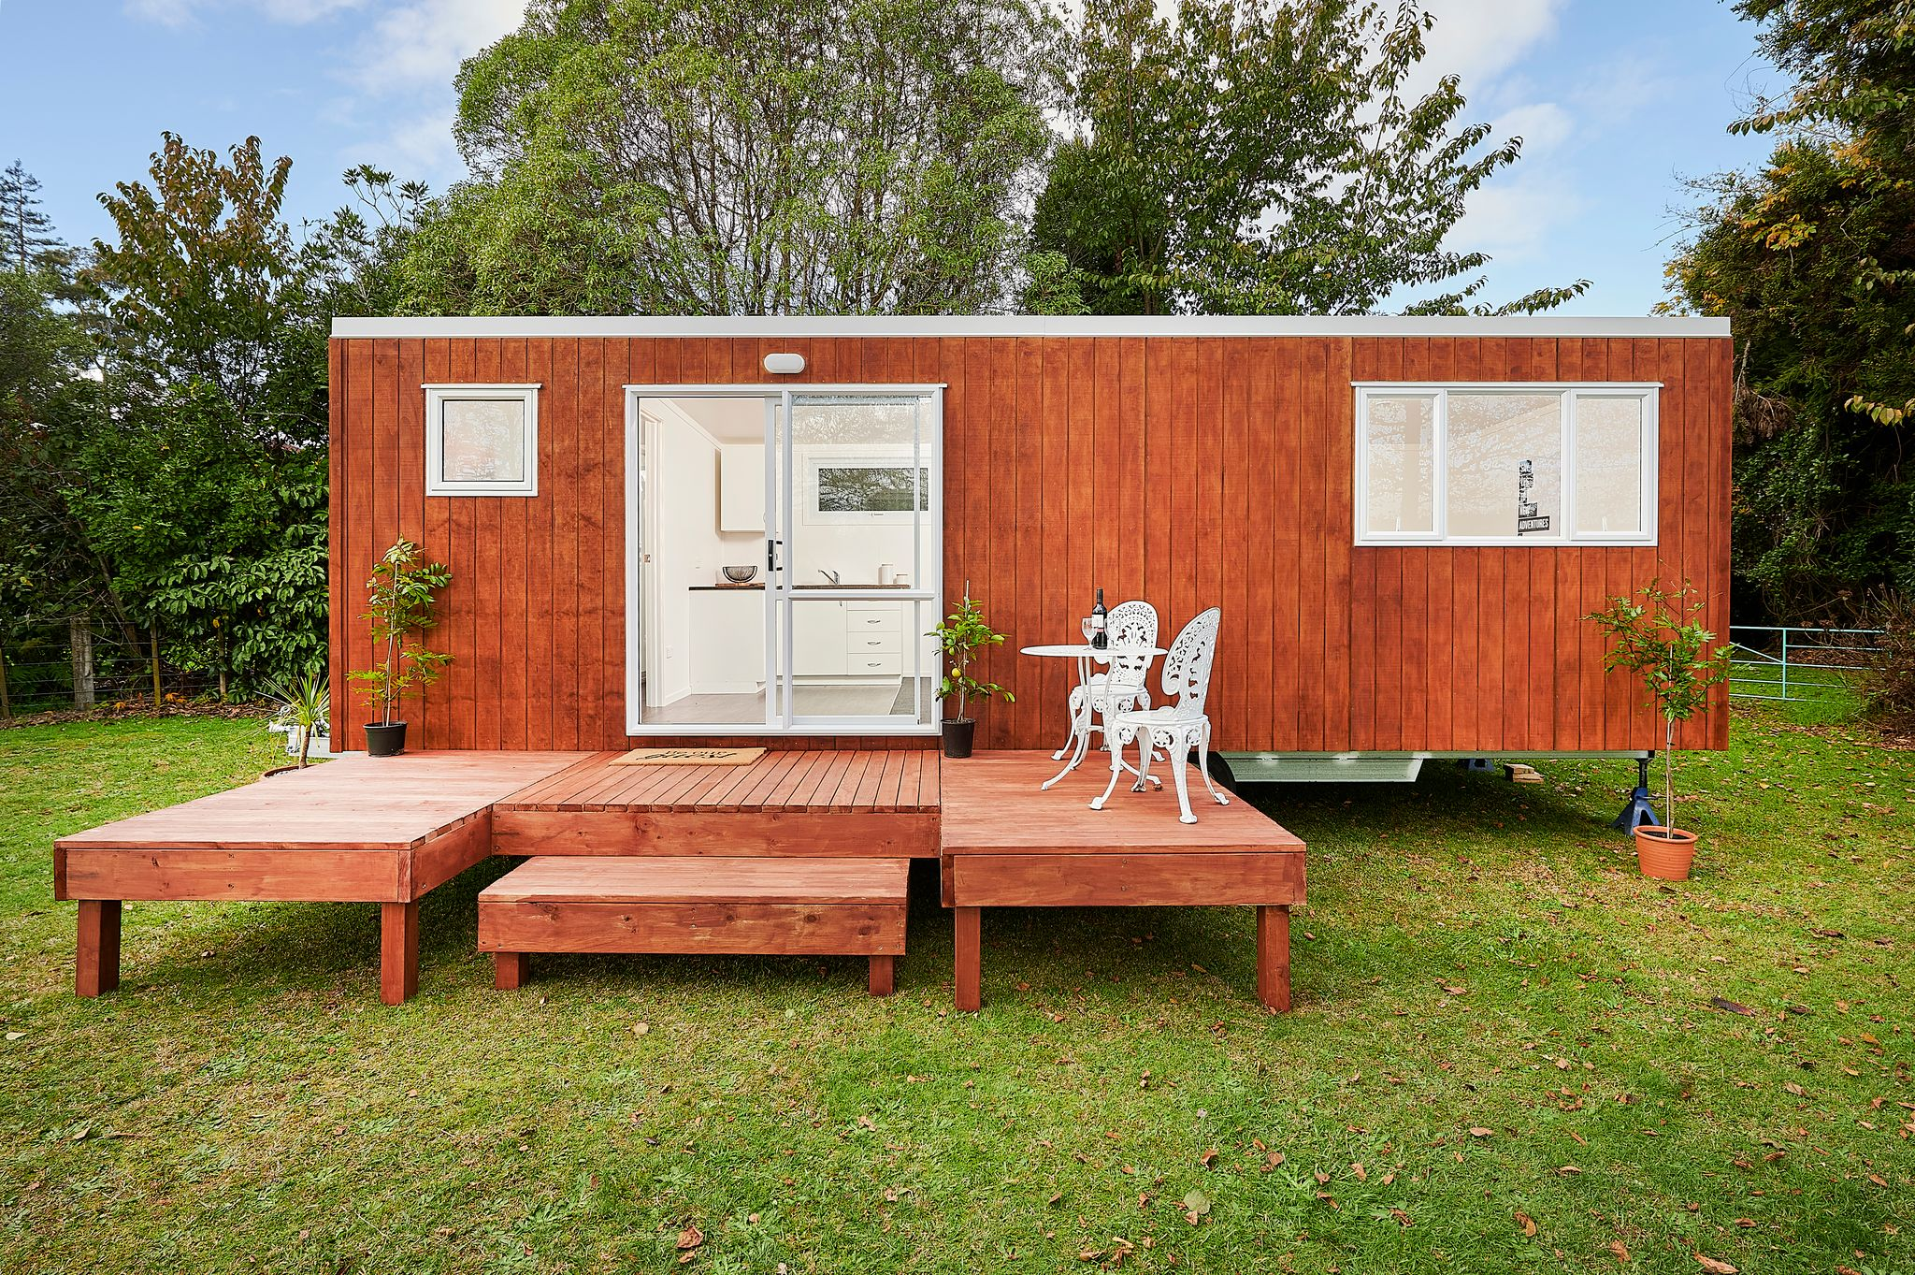
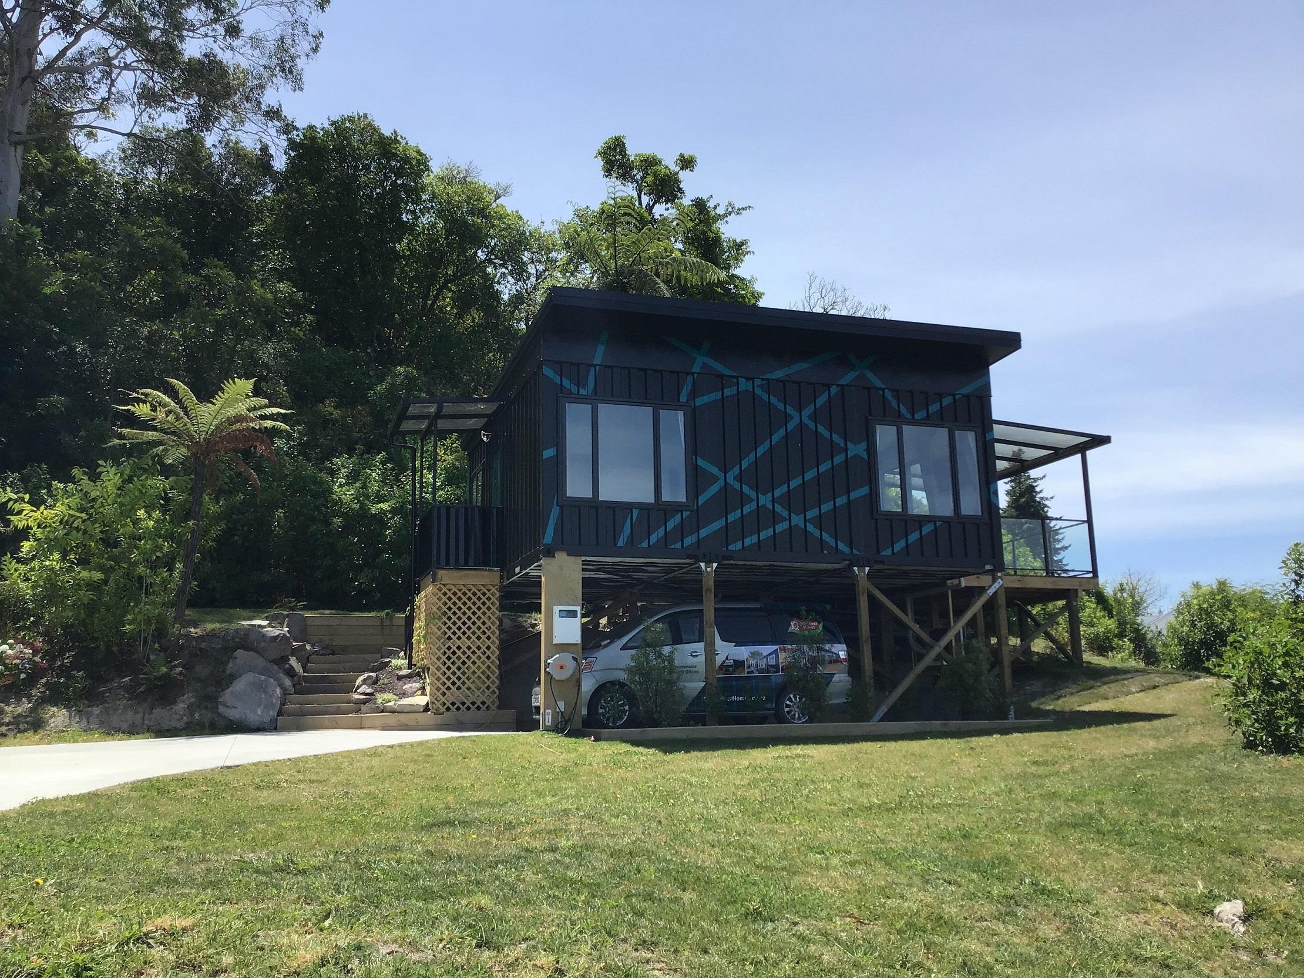
Kiwi Tiny Home Kiwi Tiny Home – Lifestyle Magazine We promote the Tiny House movement in New Zealand. We have advertising partners who pay us $500+GST a year or $50+GST to promote their business on our website and across the Kiwi Tiny Home social media page/group. Visit www.kiwitinyhome to see the promotions nb. These marketing partners also become members of the Kiwi Business Network as part of their Kiwi Tiny Home marketing deal.

Slide 6
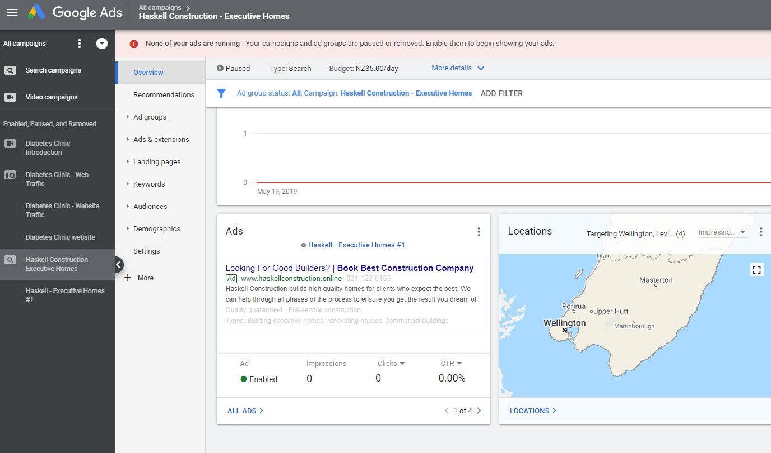
Digital Marketing Services Traditional Digital Marketing Services provides services in these main areas. - Build Websites / Social Media pages - Provide Social Media Marketing Services - Promote client websites using products like Google AdWords. Our business trains clients to do this themselves. However, we will do work for clients on an adhoc basis. This is not our main focus but when we grow we will do more with these services in the future.

